Slide 1
Normalize remoteIp In security group config pushed to ACI
In a recent Bosch issue, deletion and creation of a single pod led cni to send 900 are delete MOs (for old IP) and 900 are created Mos (for a new IP). Effect on latency:
PD-PM-Opflexproxy-agent took 5 mins to process all these Mos. After 5mins datapath for new pod started working.
Applies to both Openstack and K8s.

Slide 2
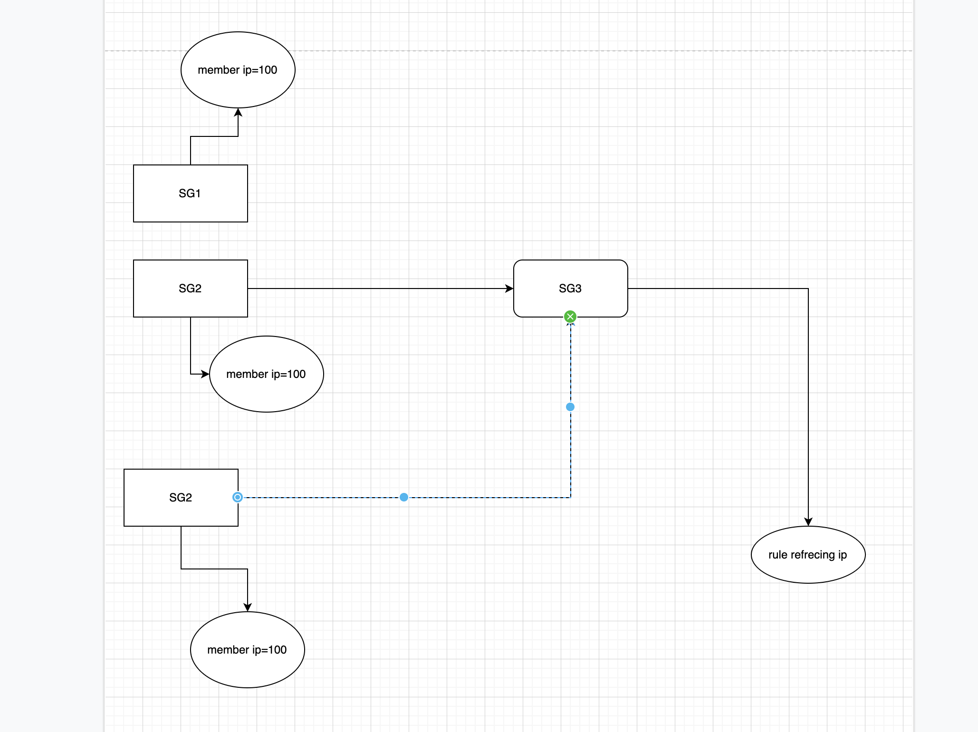
Now:

Slide 3
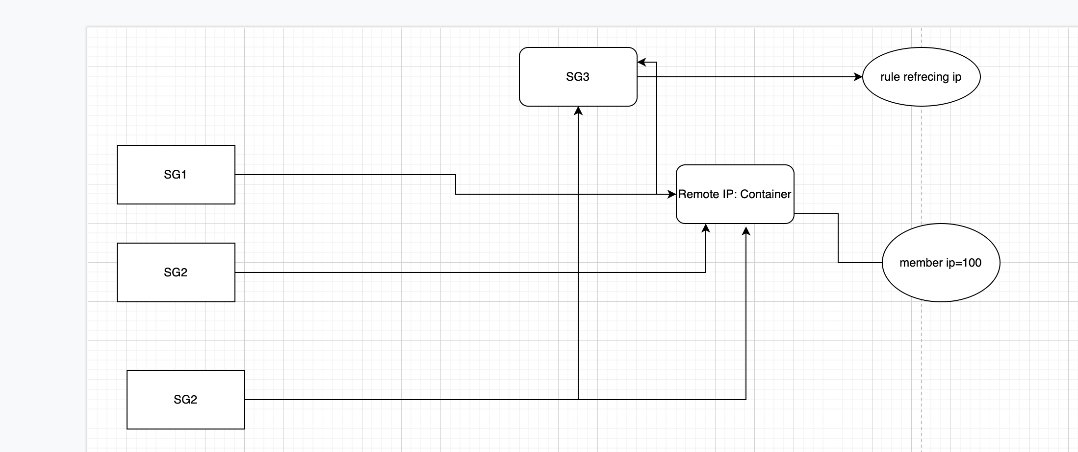
After normalization:

